Slide 1
CMSC204
Kartchner
V(StateGraph) = {Oregon, Alaska, Texas, Hawaii, Vermont, NewYork, California}
E(StateGraph) = {(Alaska, Oregon), (Hawaii, Alaska), (Hawaii, Texas), (Texas, Hawaii), (Hawaii, California), (Hawaii, New York), (Texas, Vermont), (Vermont, California), (Vermont, Alaska)}
1. Draw the StateGraph
Oregon
Vermont
Alaska
New York
Hawaii
California
Texas

Slide 2
a. Show the adjacency matrix that would describe the edges in the graph. Store the vertices in alphabetical order
States
Alaska
California
Hawaii
New York
Oregon
Texas
Vermont
0 0 0 0 1 0 0
0 0 0 0 0 0 0
1 1 0 1 0 1 0
0 0 0 0 0 0 0
0 0 0 0 0 0 0
0 0 1 0 0 0 1
1 1 0 0 0 0 0
3. b. Show the adjacency lists
that would describe the edges in the graph
Alaska
California
Hawaii
New York
Oregon
Texas
Vermont
Oregon
Alaska
California
New York
Texas
Hawaii
Vermont
Alaska
California

Slide 3
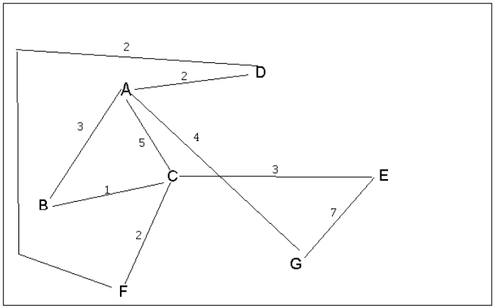
4 a. Which of the following lists the graph nodes in depth first order beginning with E?
A) E, G, F, C, D, B, A
B) G, A, E, C, B, F, D
C) E, G, A, D, F, C, B
D) E, C, F, B, A, D, G Answer: C
4 b. Which of the following lists the graph nodes in breadth first order beginning at F?
A) F, C, D, A, B, E, G
B) F, D, C, A, B, C, G
C) F, C, D, B, G, A, E
D) a, b, and c are all breadth first traversals Answer: A

Slide 4
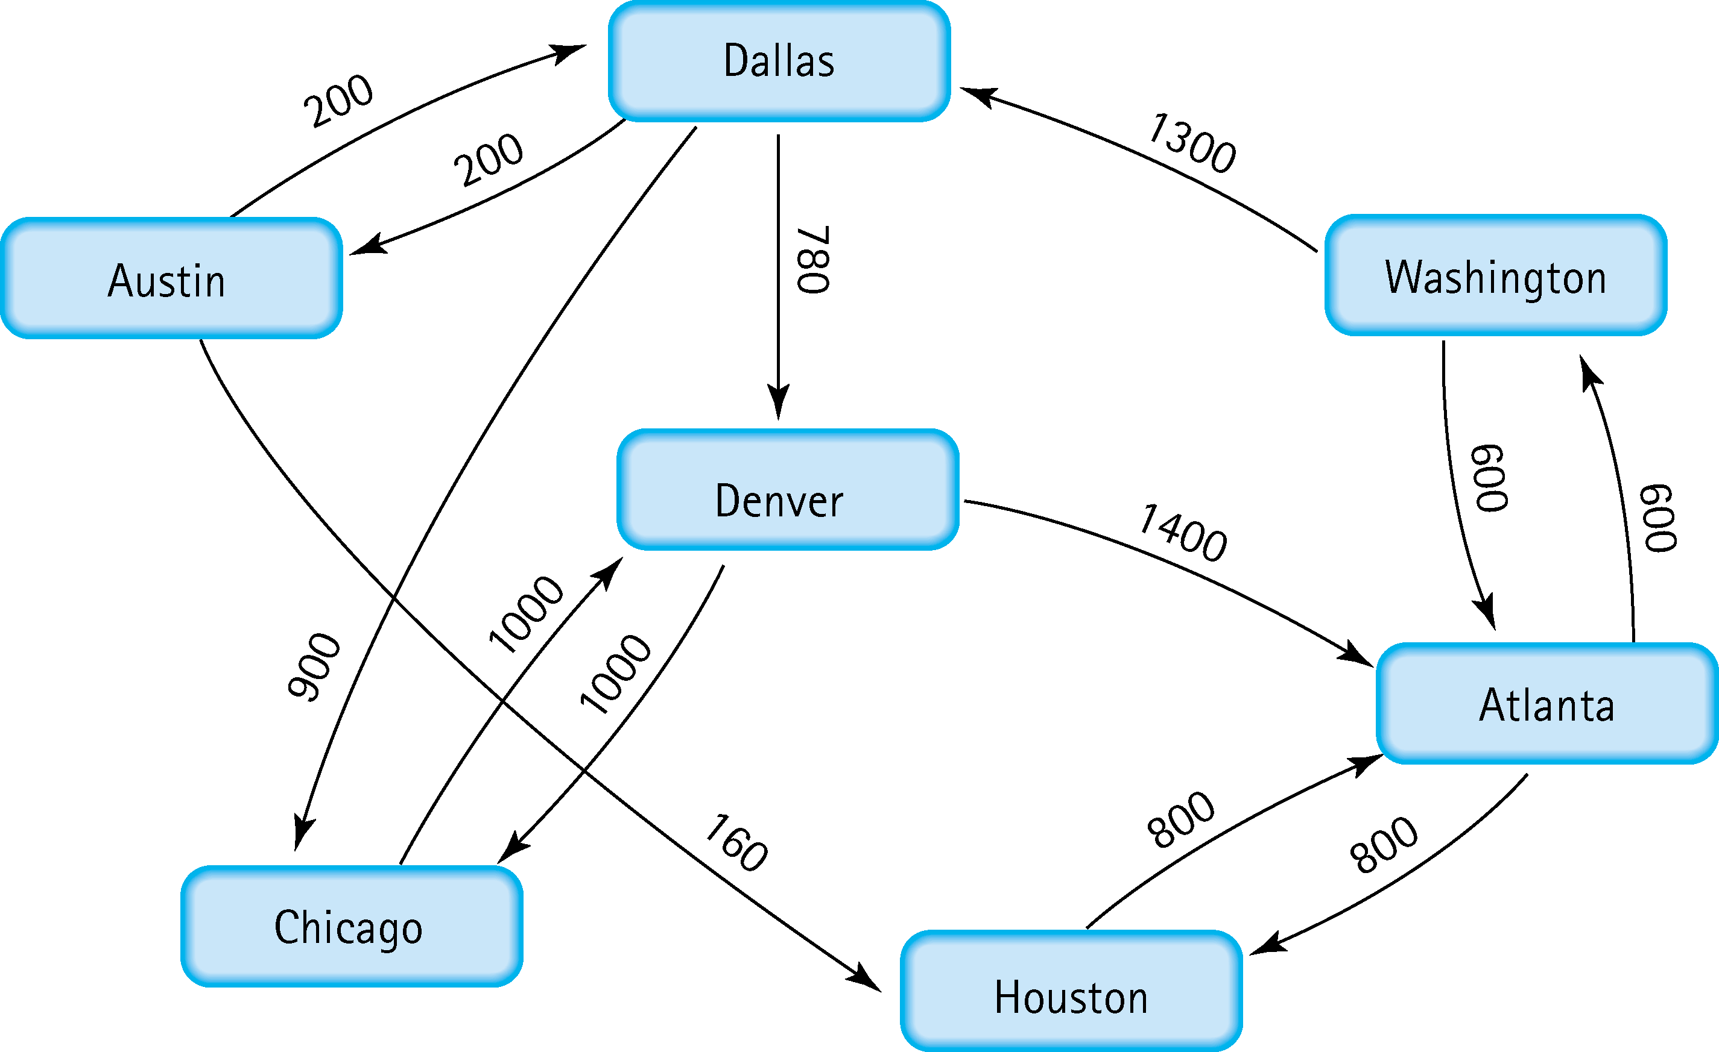
Find the shortest distance from Atlanta to every other city
Atlanta to
Austin: 2100
Chicago : 2800
Dallas: 1900
Denver: 2680
Houston: 800
Washington: 600

Slide 5
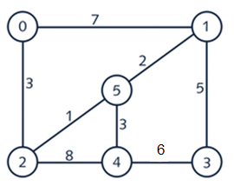




6. Find the minimal spanning tree using Prim’s algorithm. Use
0 as the source vertex . Show the steps.
Each step:
(0,2),(2,5),(5,1),(5,4),(1,3)

Slide 6


7. Find the minimal spanning tree using Kruskal’s algorithm.
Show the weights in order and the steps.
Each step
(2,5),(5,1),(2,0),(5,4),(1,3)

Slide 7
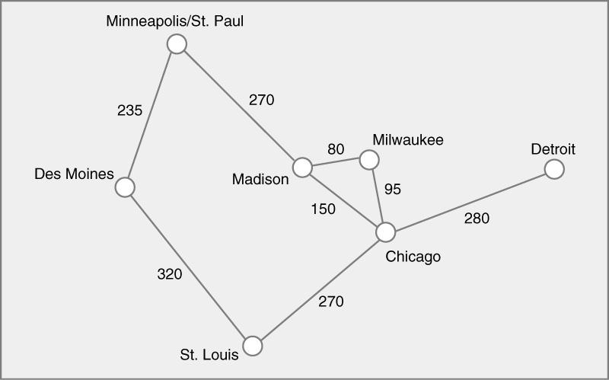




8. Find the minimal spanning tree using the algorithm you prefer. Use
Minneapolis/St. Paul as the source vertex

Slide 8
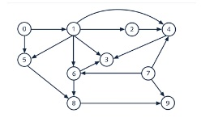
9. List the nodes of the graph in a breadth first topological ordering. Show the
steps using arrays predCount, topologicalOrder and a queue
0 1 2 3 4 5 6 7 8 9
PredCount = [0 1 1 3 3 2 2 0 2 2]
Topological Order= []
Queue = [0,7]
0 1 2 3 4 5 6 7 8 9
PredCount = [0 0 1 3 3 1 2 0 2 2]
Topological Order= [0]
Queue = [7 1]
0 1 2 3 4 5 6 7 8 9
PredCount = [0 0 1 3 2 1 1 0 2 1]
Topological Order= [0 7 ]
Queue = [1]
0 1 2 3 4 5 6 7 8 9
PredCount = [0 0 0 2 1 0 0 0 2 1]
Topological Order= [0 7 1 ]
Queue = [2 5 6 ]
0 1 2 3 4 5 6 7 8 9
PredCount = [0 0 0 2 0 0 0 0 2 1]
Topological Order= [0 7 1 2]
Queue = [ 5 6 4 ]
0 1 2 3 4 5 6 7 8 9
PredCount = [0 0 0 0 0 0 0 0 0 0]
Topological Order= [0 7 1 2 5 6 4 8 3 9]
Queue = []

Slide 9
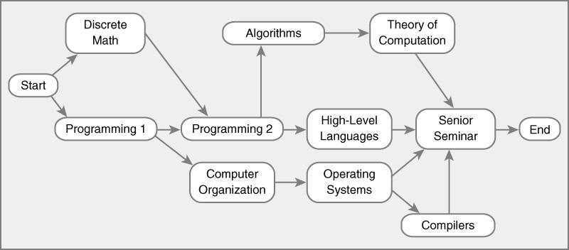
10. List the nodes of the graph in a breadth first topological ordering.
Start – Discrete Math – Programming 1 – Programming 2 – Computer Organization – Algorithms – High Level Languages – Operating Systems – Theory of Computation – Compilers – Senior Seminar – End

